Slide 1

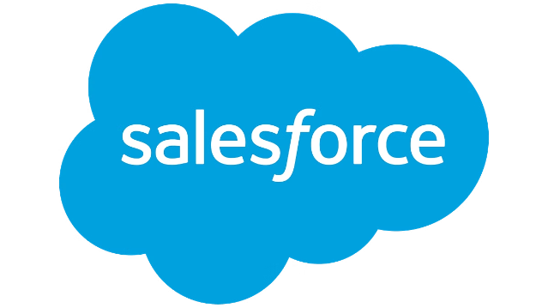
Introduction to Salesforce
Salesforce is a powerful cloud-based customer relationship management (CRM) platform that helps businesses streamline their sales, marketing, and customer service processes. It offers a comprehensive suite of tools and applications to enhance productivity, collaboration, and data-driven decision making.
Presented by : Akshata A. Gedam (AD21030)

Slide 2

Salesforce Platform Overview
Clouds
Lightning
AppExchange
Salesforce's core offerings are organized into "Clouds" such as Sales Cloud, Service Cloud, and Marketing Cloud, each tailored to address specific business needs.
The platform's Lightning Experience provides a modern, intuitive user interface that simplifies navigation and improves overall productivity.
The Salesforce AppExchange is a marketplace of pre-built applications and integrations that allow businesses to customize and extend the platform's capabilities.

Slide 3

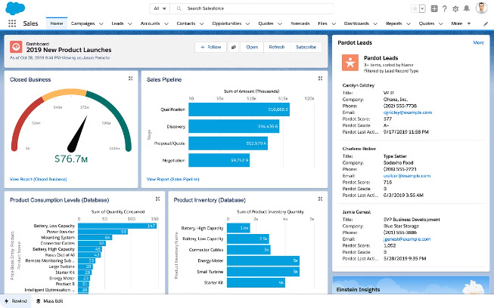
Sales Cloud: Streamlining the Sales Process
1
Lead Management
Efficiently capture, nurture, and qualify leads to maximize sales opportunities.
2
Opportunity Tracking
Gain visibility into the sales pipeline and forecast future revenue with ease.
3
Collaboration and Mobility
Enable sales teams to access and update customer data from anywhere, on any device.

Slide 4
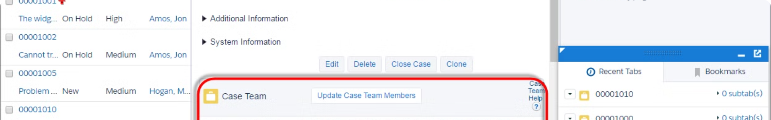
Service Cloud: Enhancing Customer Service
Case Management
Self-Service Portal
Streamline the resolution of customer inquiries and issues with a centralized case management system.
Empower customers to find answers and solve problems on their own through a user-friendly self-service portal.
Agent Productivity
Knowledge Management
Equip customer service agents with the tools and insights they need to deliver exceptional support.
Leverage a centralized knowledge base to provide consistent, accurate information to both customers and agents.

Slide 5

Marketing Cloud: Personalized Customer Engagement
Omni-Channel Engagement
Audience Segmentation
Automation and Optimization
Seamlessly engage customers across email, social media, mobile, and other channels to deliver a consistent brand experience.
Use powerful segmentation and personalization tools to tailor marketing campaigns to specific customer needs and preferences.
Automate marketing workflows and continuously optimize campaigns to improve efficiency and drive better results.

Slide 6


Salesforce Einstein: Artificial Intelligence for Business
1
Predictive Analytics
Leverage AI-powered insights to forecast sales, identify upsell opportunities, and proactively address customer needs.
2
Intelligent Automation
Automate repetitive tasks and workflows to boost productivity and free up employees to focus on strategic initiatives.
3
Natural Language Processing
Analyze customer conversations and sentiment to deliver personalized experiences and tailored recommendations.
4
Computer Vision
Automatically categorize and take action on visual data, such as images and documents, to streamline business processes.

Slide 7

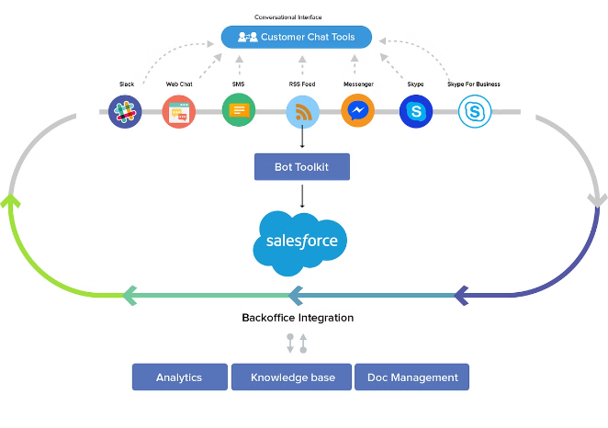



Salesforce Integration: Connecting Your Ecosystem
Data Connectors
Seamlessly integrate Salesforce with other enterprise systems, enabling a 360-degree view of customer data.
Middleware Solutions
Leverage platforms like MuleSoft to create custom integrations and automate cross-application workflows.
API-Driven Customization
Extend Salesforce's capabilities by building custom applications and components using the platform's robust API ecosystem.

Slide 8

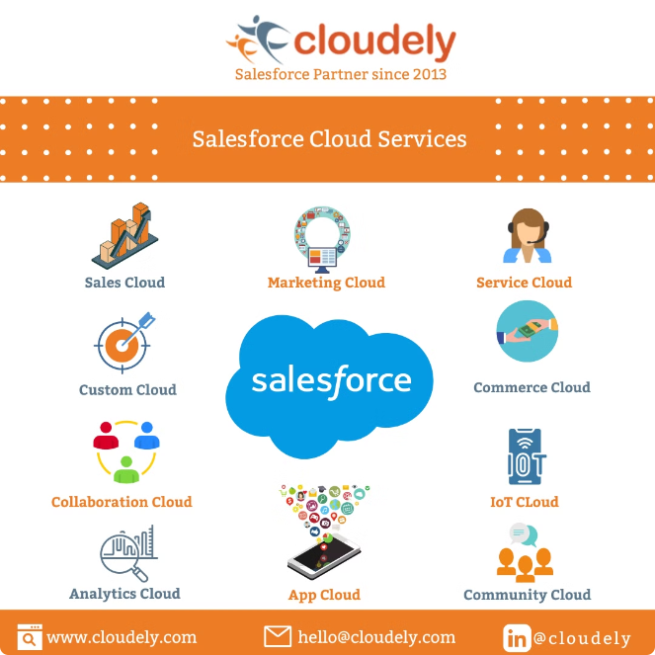
Salesforce Ecosystem: Partners and Developers
Partner Programs
Salesforce partners offer a wide range of complementary products, services, and expertise to extend the platform's capabilities.
AppExchange
The Salesforce AppExchange is a marketplace of pre-built applications, integrations, and solutions, enabling businesses to quickly customize and extend Salesforce.
Trailblazer Community
The Trailblazer community is a global network of Salesforce users, developers, and experts who share knowledge, collaborate, and drive innovation.

Slide 9

Salesforce Success: Customer Stories and ROI
Increased Productivity
Enhanced Customer Experiences
Customers report significant improvements in productivity and efficiency after implementing Salesforce.
Businesses using Salesforce are able to deliver more personalized and engaging customer experiences.
Accelerated Growth
Measurable ROI
Salesforce helps organizations streamline their operations and drive sustainable business growth.
Customers consistently report a positive return on their Salesforce investment, with a rapid payback period.

Slide 10

THANK YOU

